Slide 1


Awakening What's Possible
Optix
Small Tools Inventory Management
Built specifically for Urban Infraconstruction LLC to bring total accountability and real-time visibility to field operations.
PREPARED FOR
PRESENTED BY
DATE
Urban Infraconstruction LLC
Bodhi Labs
September 2026

Slide 2















EXECUTIVE PRESENTATION AGENDA
1. Purpose & Core Friction
2. System Architecture
3. Small Tools Register
The operational purpose and financial drain caused by poor tool tracking in field operations today.
One tool, one truth—connected modules delivering live fleet visibility across multiple job sites.
Centralized database cataloging makes, models, tags, serial numbers, and live active statuses.
4. Custody Chain Architecture
5. Tools by Jobsite & Analytics
6. Role Access & Outcomes
Field handoffs, transfers, approval queues, and immutable activity audit logs.
Crew allocations, live job dashboards, project capital distribution, and report logs.
Tailored workflows for superintendents, PMs, foremen, and measurable business value.

Slide 3


PURPOSE & OPERATIONAL CHALLENGES
Eliminating Field Friction & Financial Waste Across Urban Infraconstruction Projects
Operational Pain Points Today
The Optix Solution
•
Capital Waste: Tools that cannot be located get re-purchased repeatedly, driving up unnecessary capex.
Turn tool custody from a memory game into a live, mathematical system that Urban Infraconstruction can trust completely.
•
Idle Downtime: Crews standing around hunting for equipment burn labor budgets at high site crew rates.
Every asset owned has a single, trustworthy answer to "Where is it, and who holds it?"—accessible instantly on field mobile devices without paperwork.
•
Offboarding Gaps: Departing workers leave without systematic checks on held inventory, causing asset loss.

Slide 4
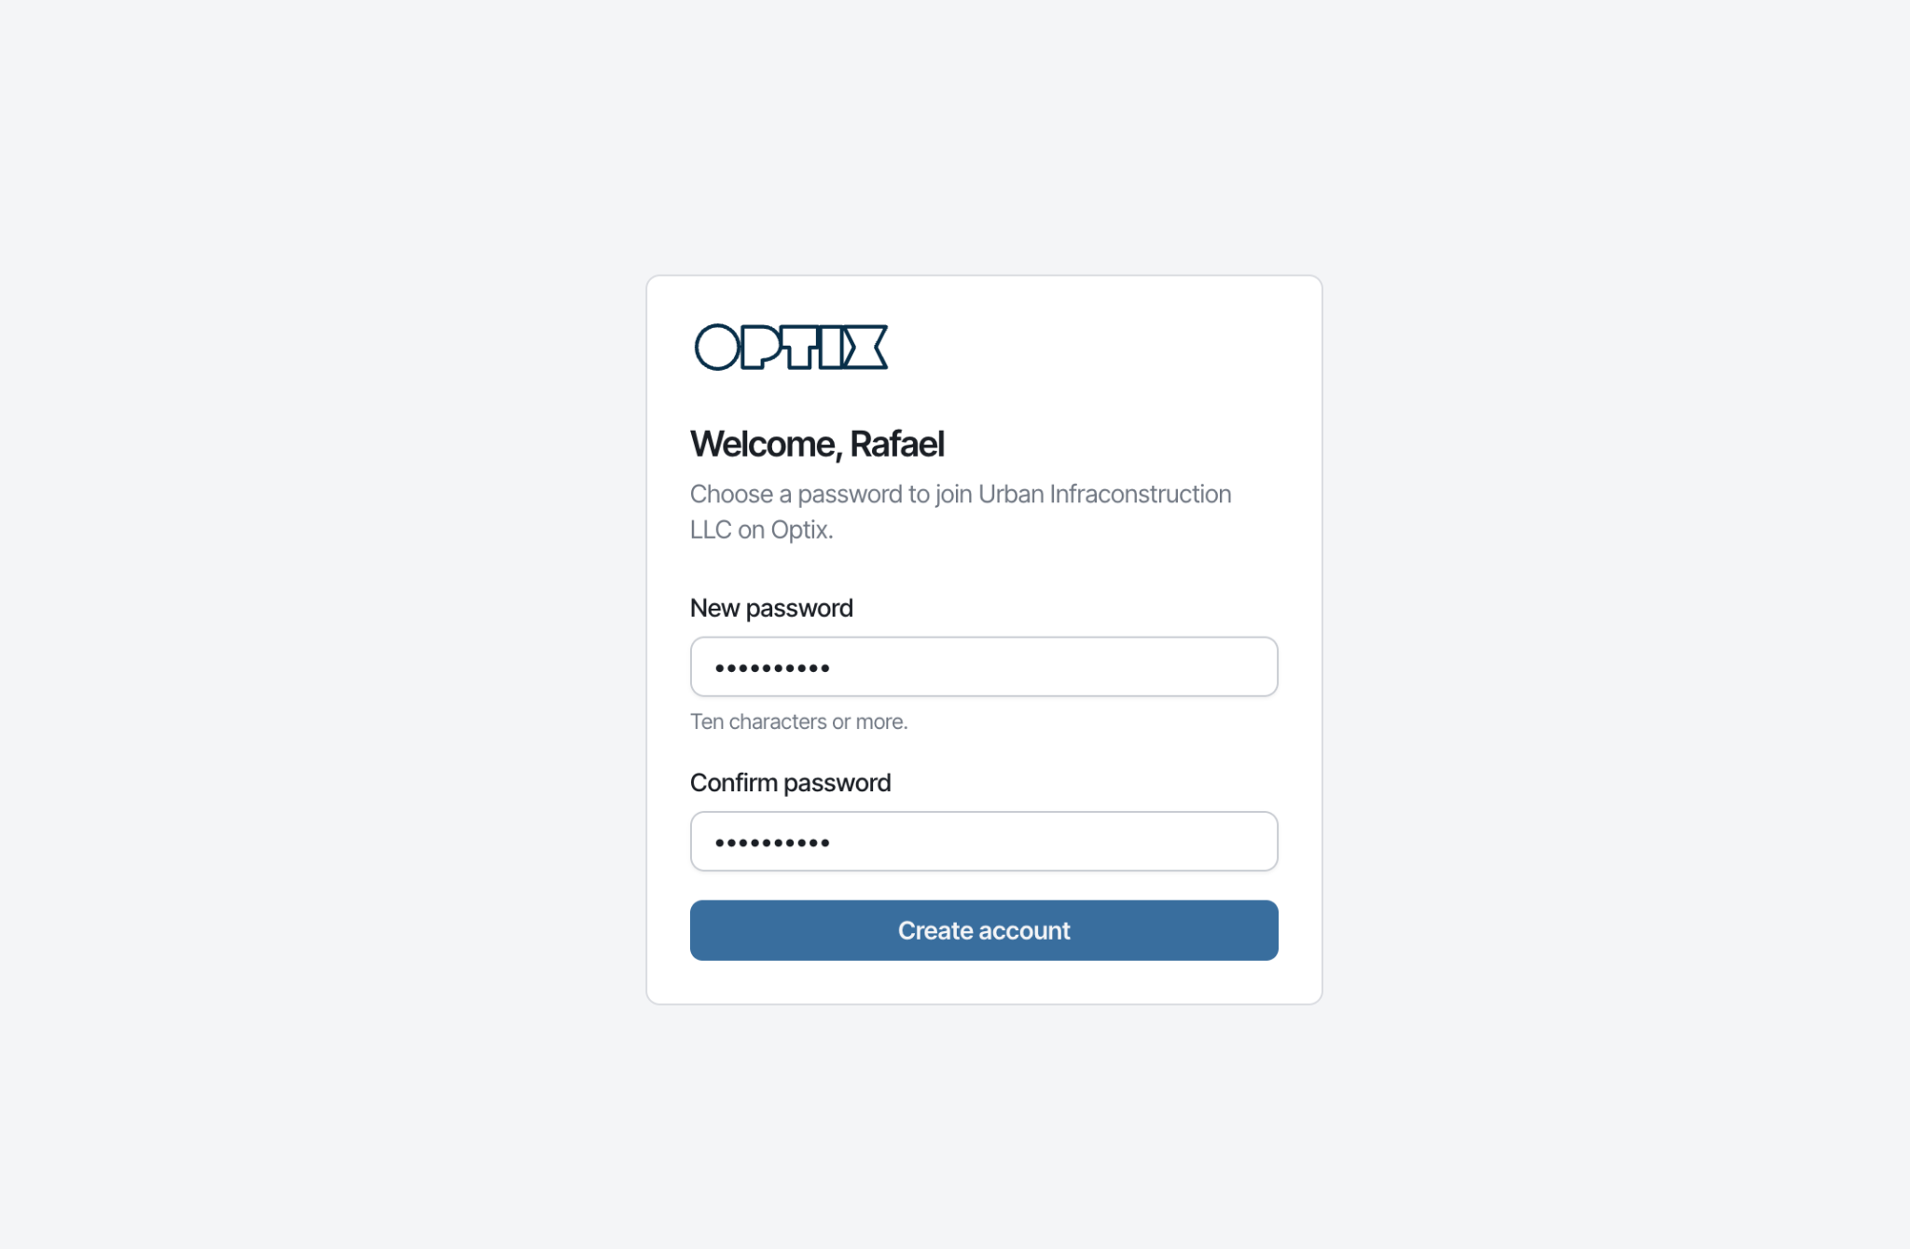
Onboarding
Bodhi Labs · Optix Small Tools Inventory
Purpose & Problem

Slide 5
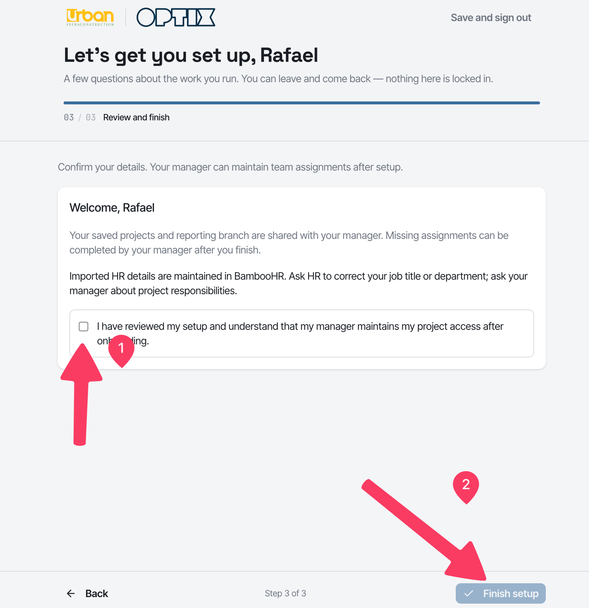
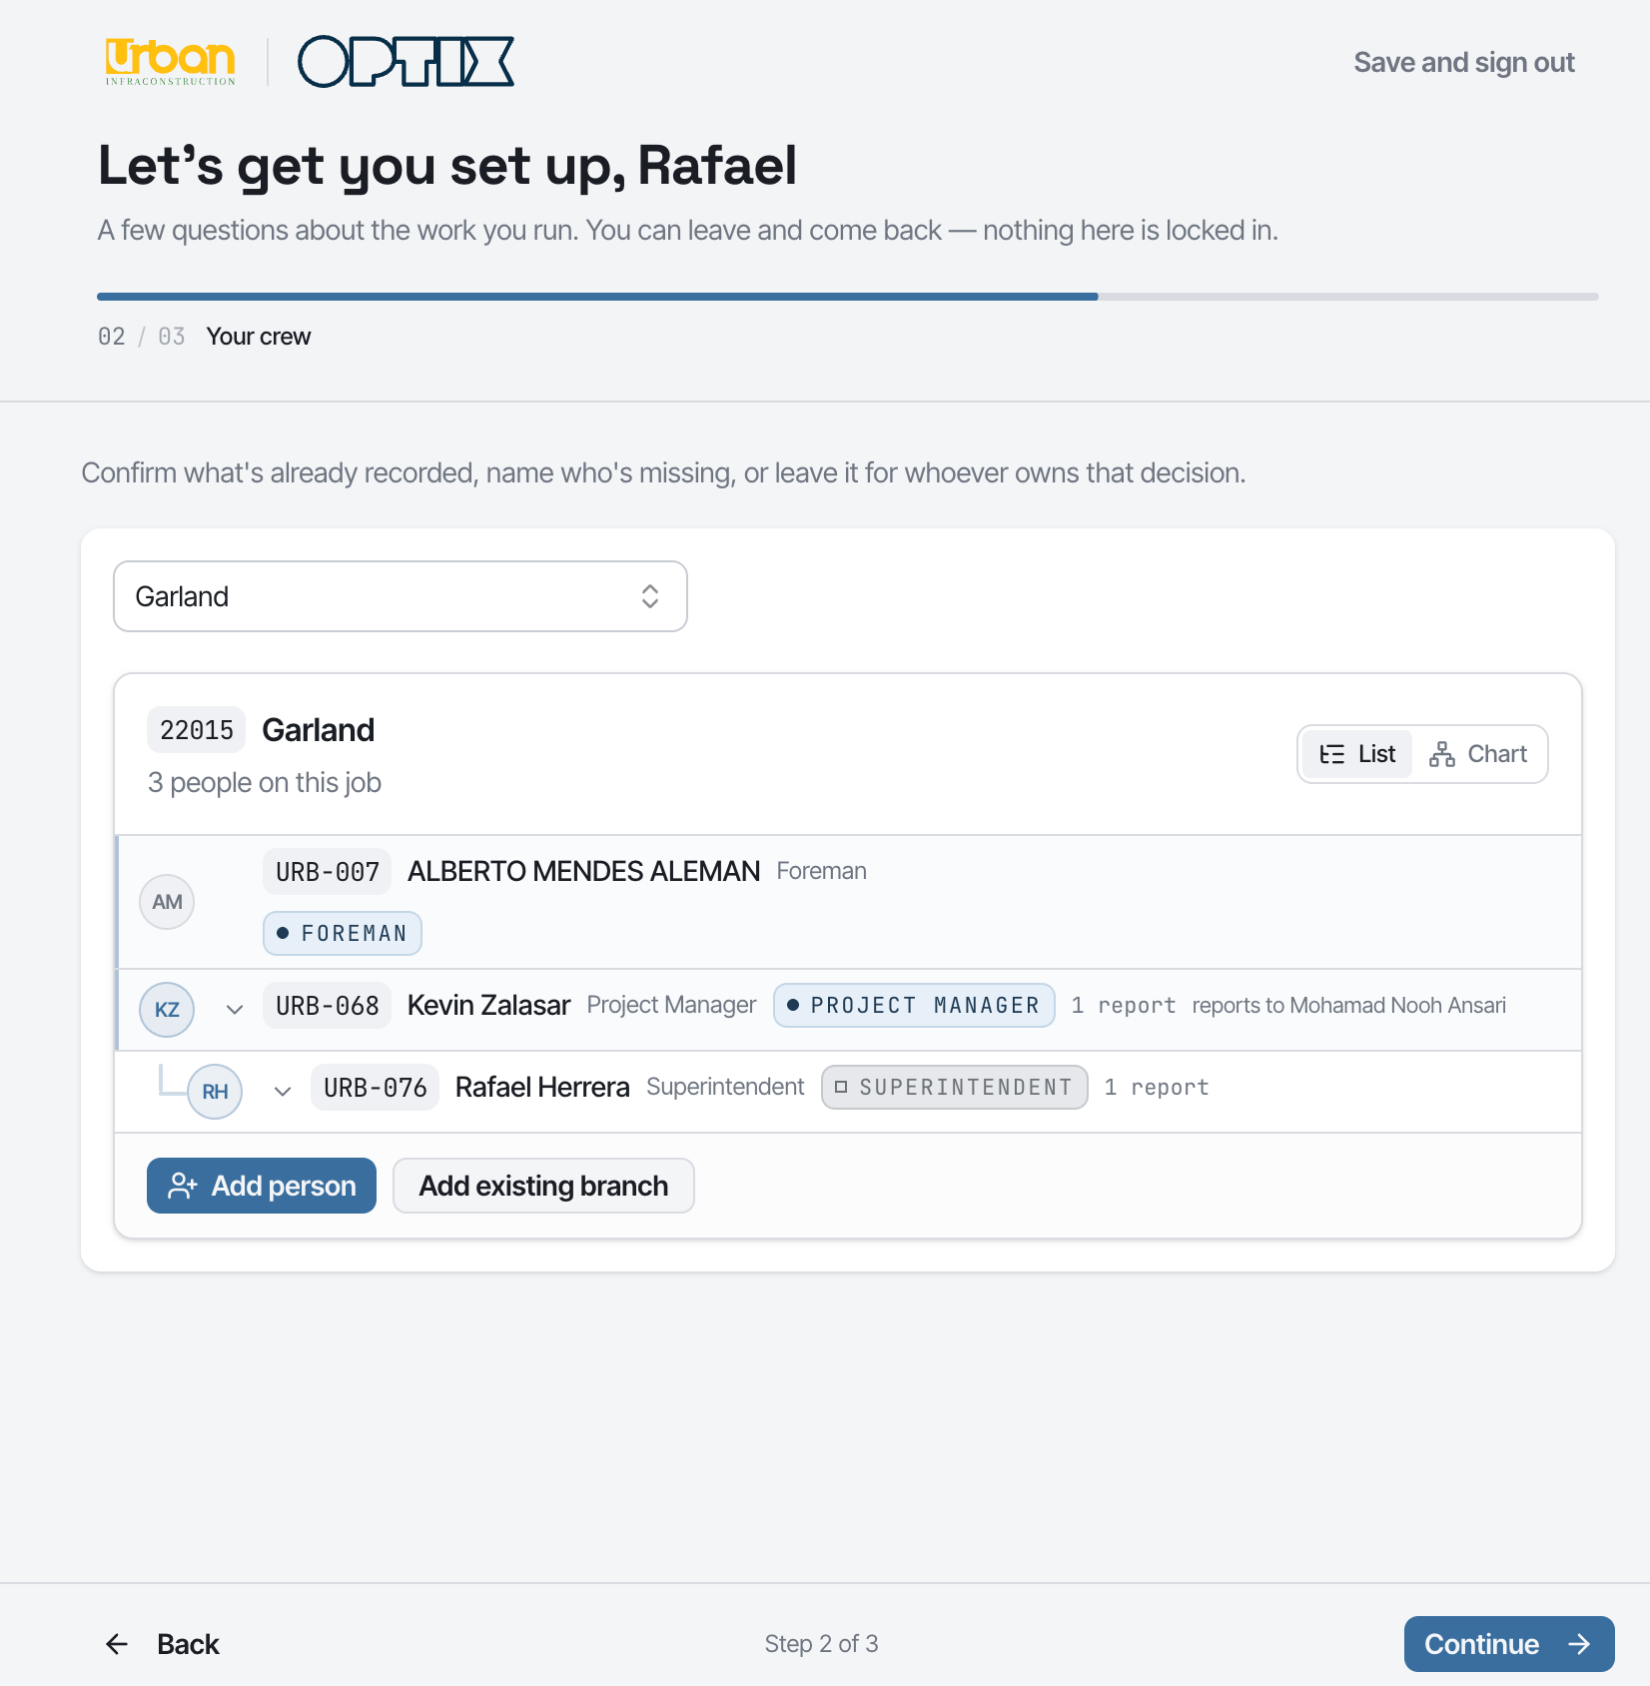

Slide 6
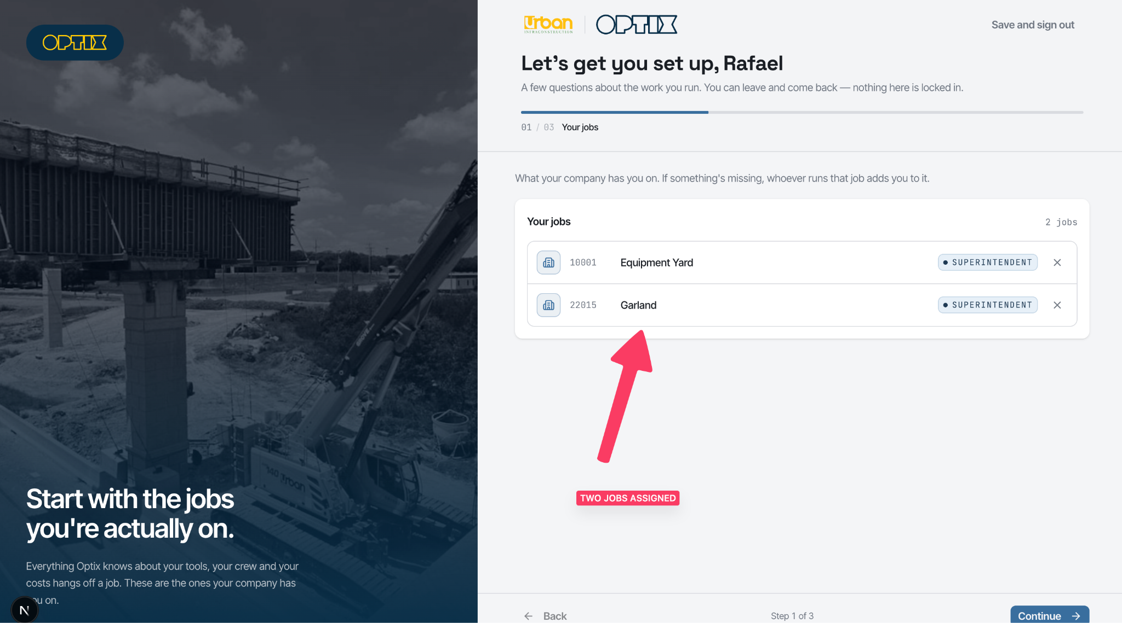

Slide 7
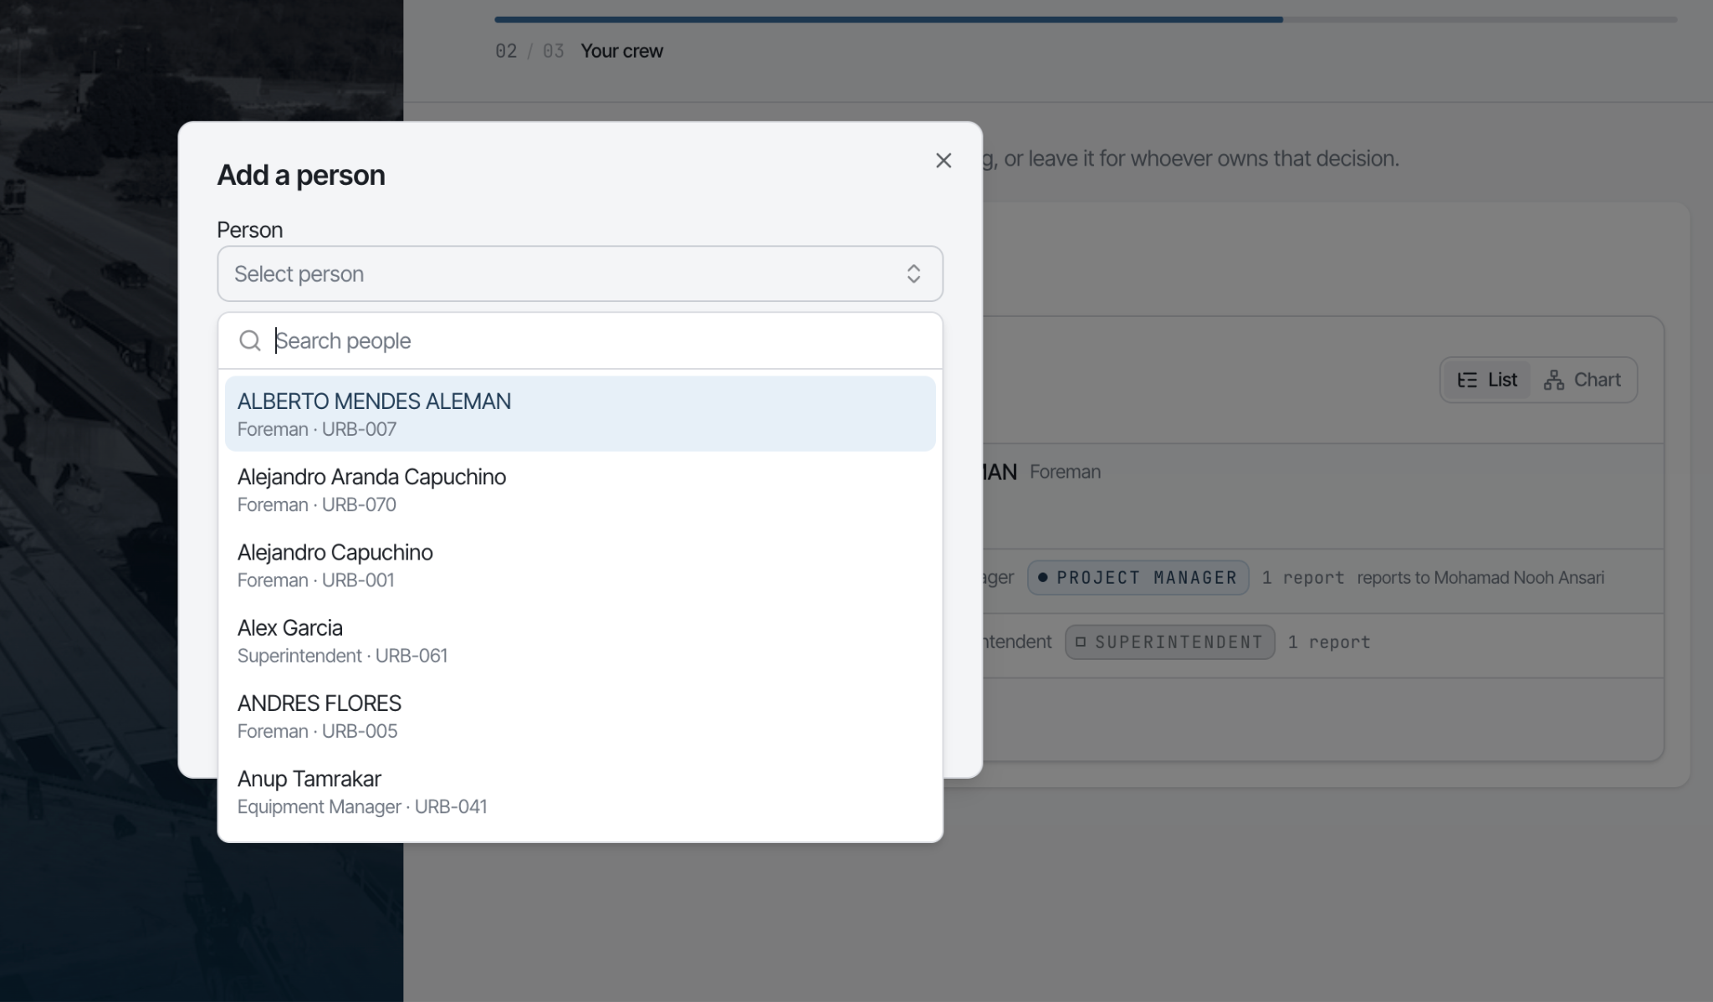

Slide 8
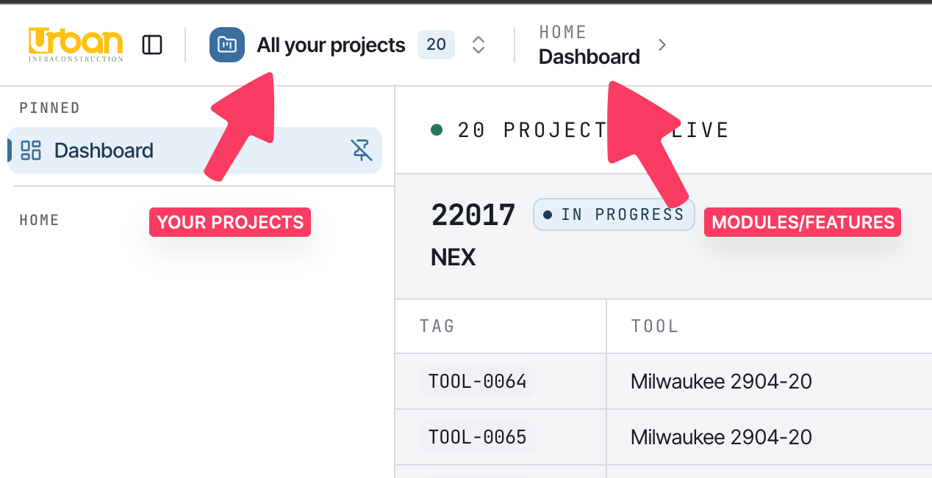
How Optix is laid out
Bodhi Labs · Optix Small Tools Inventory
Purpose & Problem

Slide 9
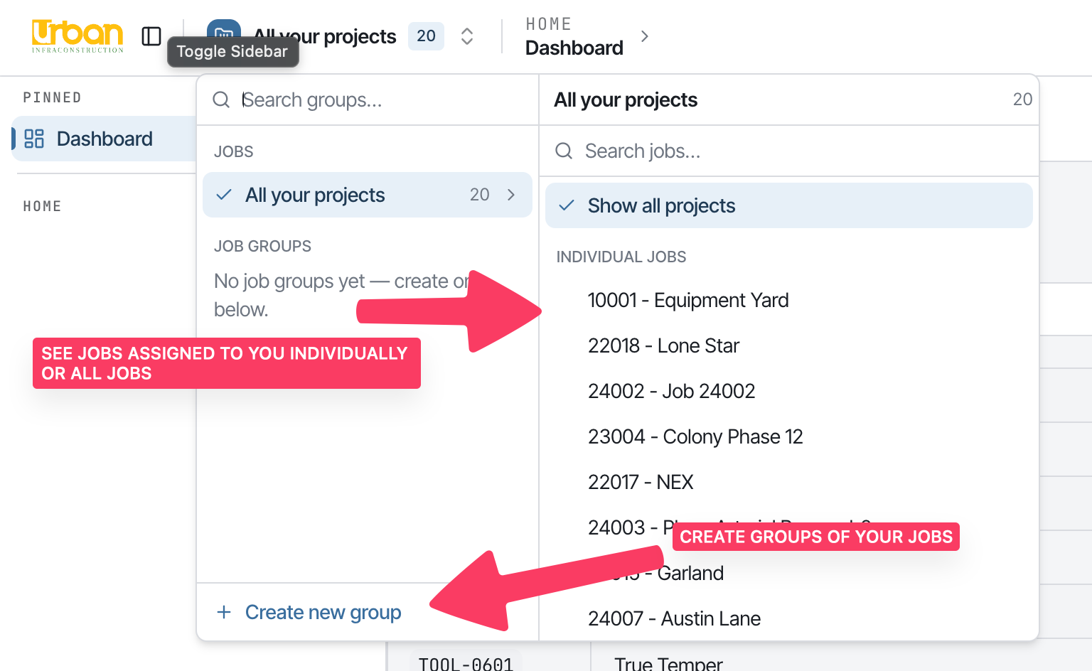
How Optix is laid out
See everything in a job or all job or group of job
You can be assigned to multiple job
But jobs can be view individually for all the features, view all the jobs or create your own group of jobs
Bodhi Labs · Optix Small Tools Inventory
Purpose & Problem

Slide 10
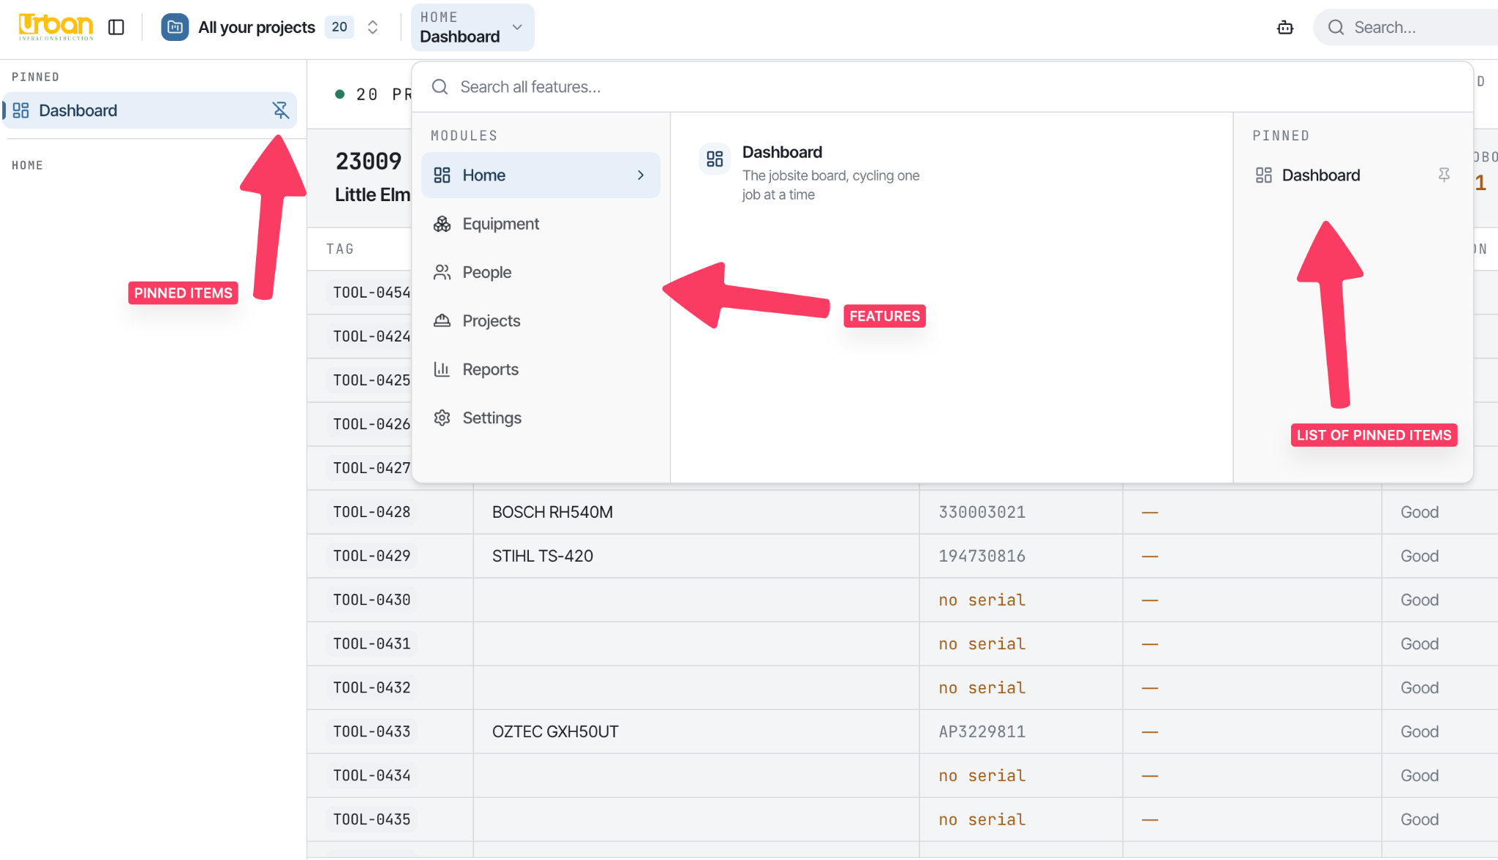
How Optix is laid out
Bodhi Labs · Optix Small Tools Inventory
Purpose & Problem

Slide 11
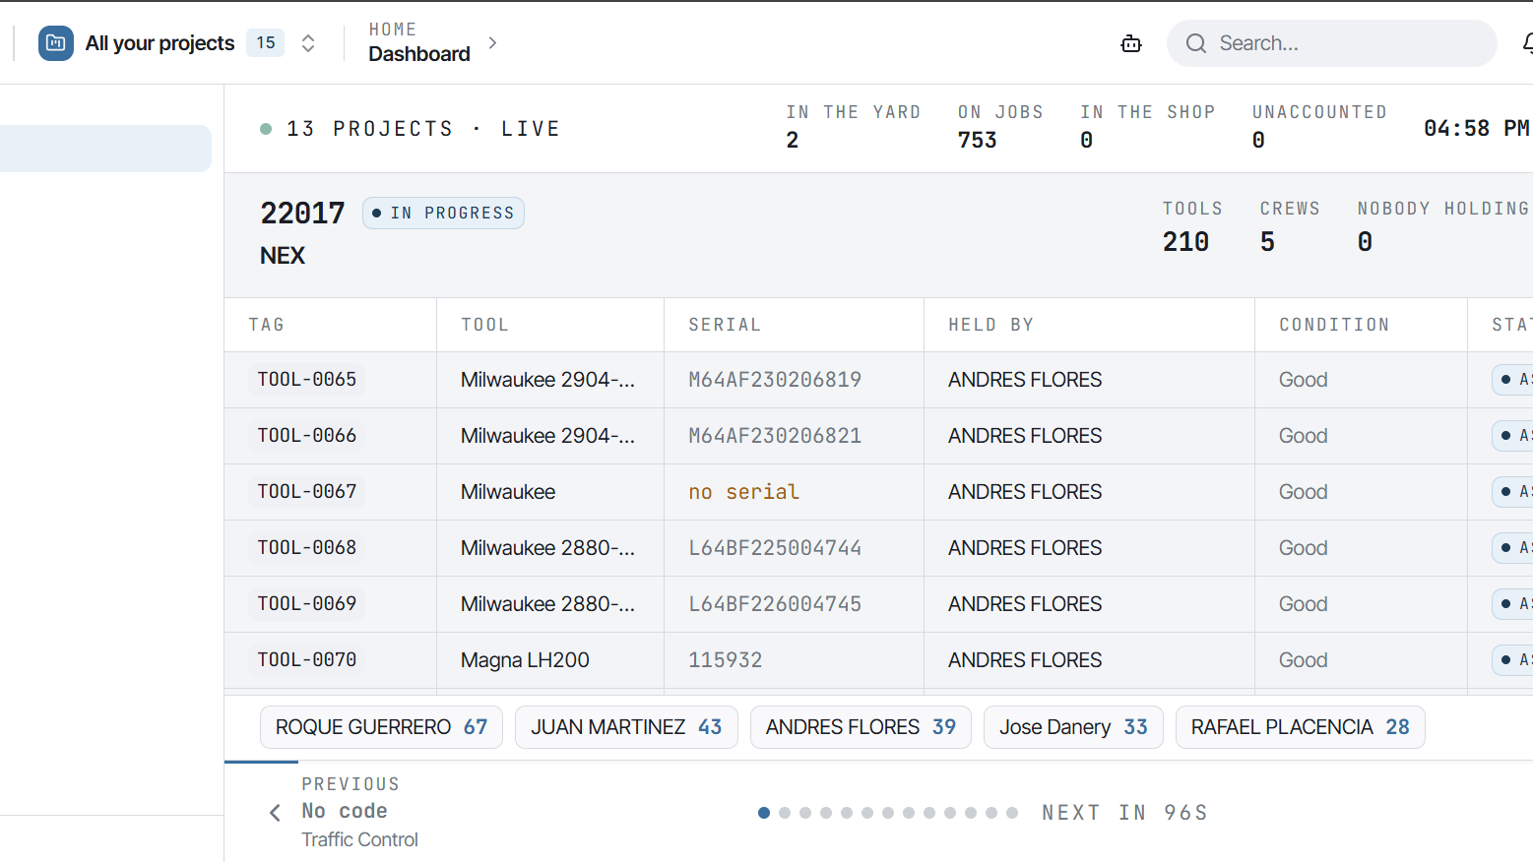

Slide 12
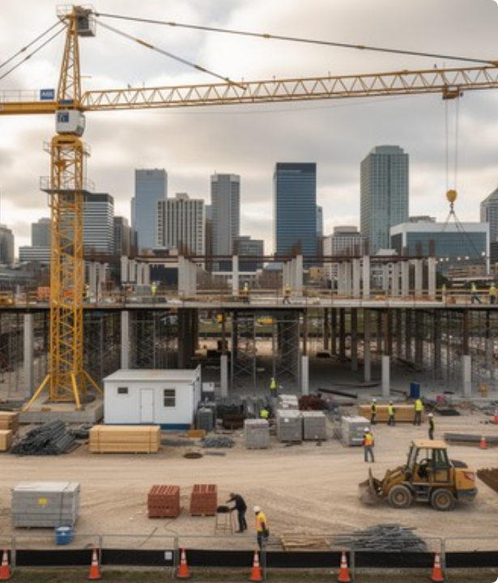
VISION: ONE TOOL. ONE TRUTH.
Connected Field Intelligence
Optix connects yard equipment desks, field managers, and site crews through a single unified digital network.
Centralized Identity: Every tool carries a unique tool ID linked to its specs and active holder.
Live Custody Chain: Real-time hand-offs recorded instantly during site arrivals and transfers.
Executive Audit Trails: Immutable logs providing complete compliance for loss and usage.

Slide 13

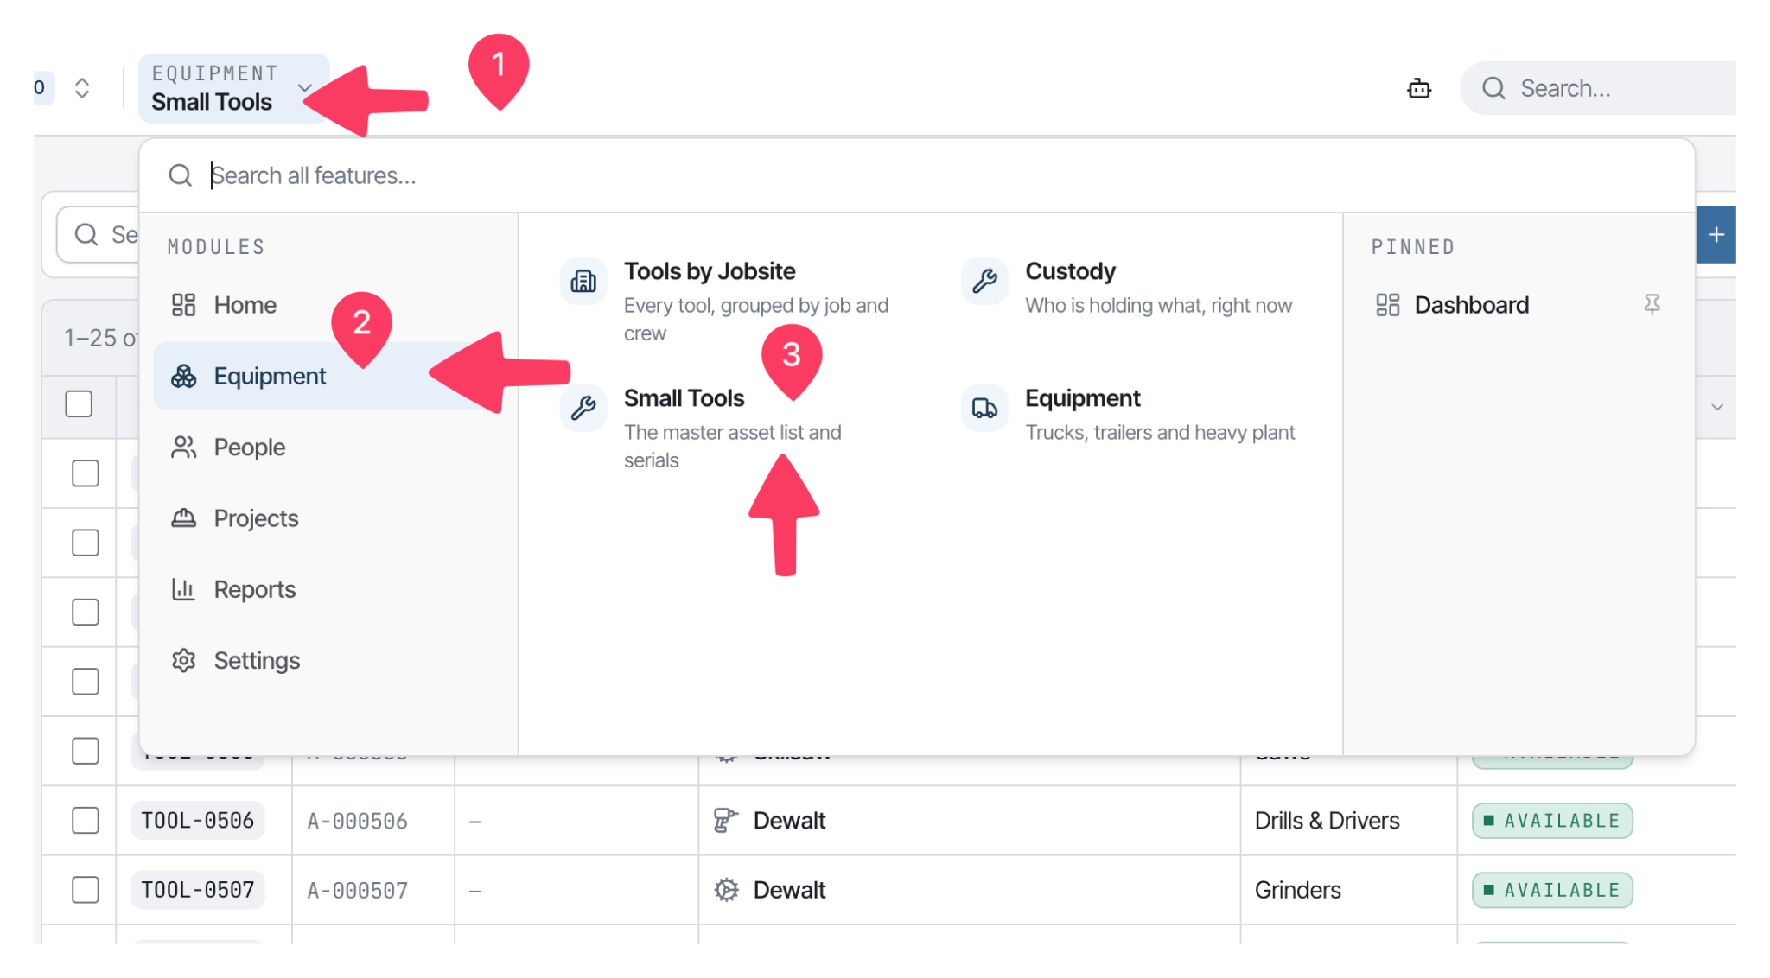
Small Tools Register
Centralized Asset Identity
Over 750+ small tools individually tracked with complete identity specifications.
Unique Tag & Ref #: Custom code indexing for rapid searching in the field.
Categorization: Grouped into Generators, Blowers, Power Tools, Yard gear, and Supplies.
Live Assigned Holder: Instant visibility into who holds each specific tool.
Global Search: Instant filtering by model, serial number, tag, or jobsite.
Bodhi Labs · Optix Small Tools Inventory
Tool Register

Slide 14
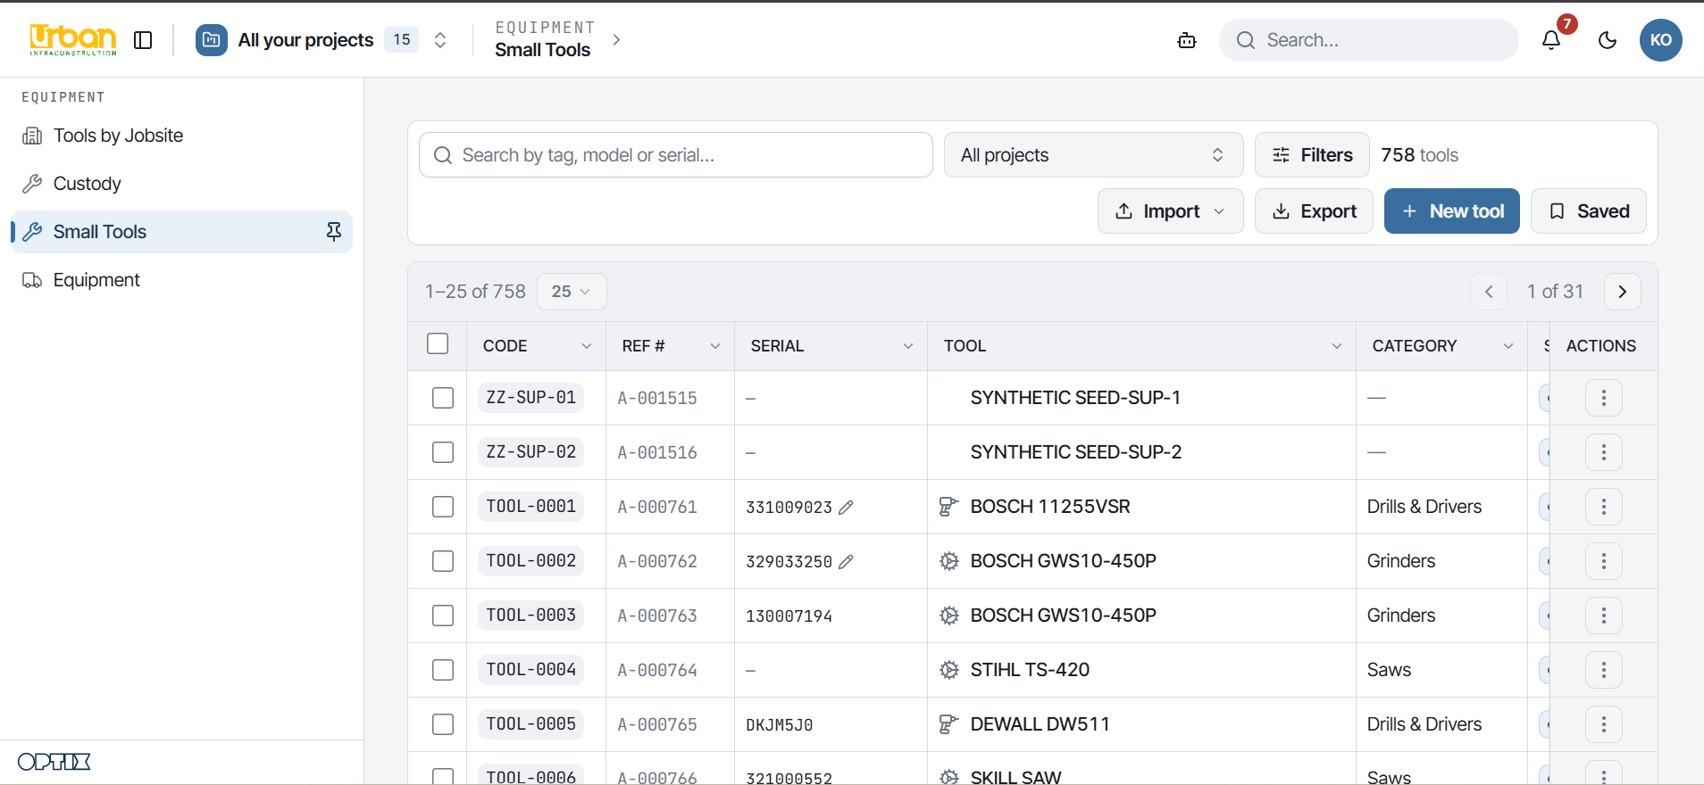

Slide 15


CUSTODY CHAIN ARCHITECTURE
Calculated from Unbroken Hand-Offs
Where a tool is located is never typed manually—it is mathematically derived from an unbroken chain of field custody records.
Ownership vs. Custody: Ownership (who paid) and custody (who currently holds it) are tracked separately.
Held Assets: Currently in active possession of a specific foreman, superintendent, or shop.
Moving Assets: Marked as "Moving" during transfer between job sites until received.
Approval Queue: Awaiting digital sign-off by superintendents or equipment desk.

Slide 16
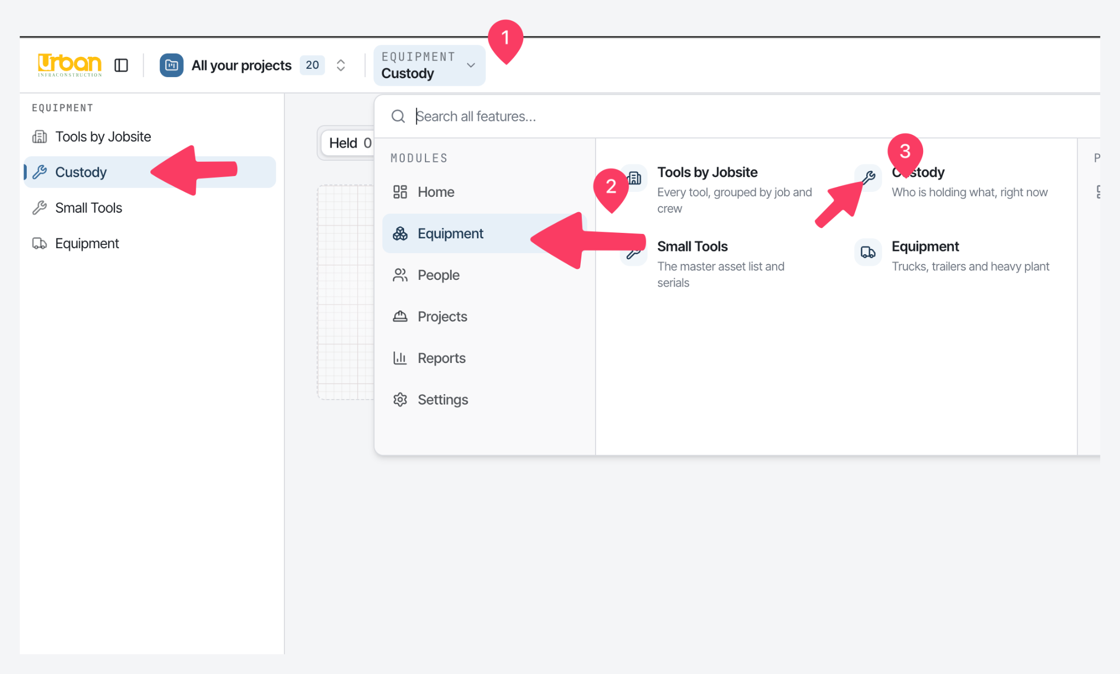

Slide 17
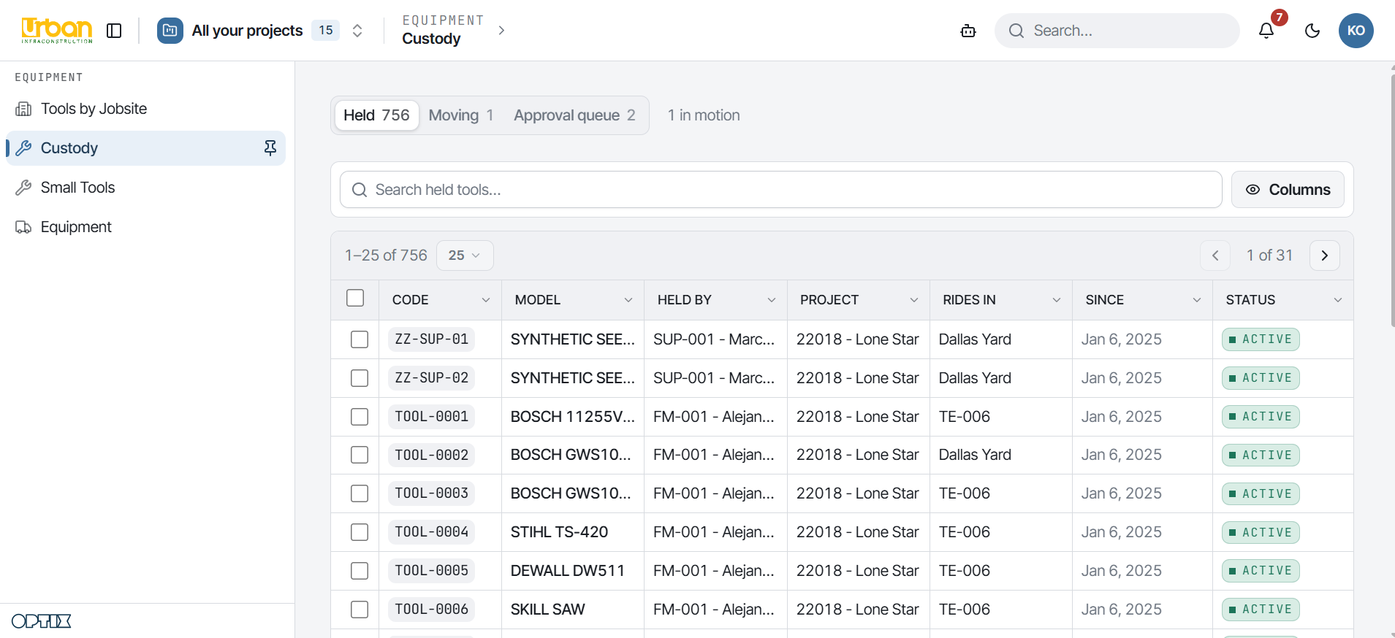

Slide 18




4-STAGE HAND-OFF LIFECYCLE
Every Physical Tool Movement Requires Clear Confirmation—Zero Phantom Tools in Transit
1. Tag & Register
2. Assign to Crew
3. Transfer
4. Yard Return
New tool enters central register; tool ID is created
Issued to foreman & charged to specific project account.
Field transfer initiated; requires 1-tap confirmation by receiver.
Cleared back to equipment desk or reassigned instantly.
Security Protocol: If a field transfer is not confirmed by the recipient within 24 hours, automated alerts notify the site superintendent.

Slide 19




IMMUTABLE CUSTODY AUDIT LOG
Complete Activity History Recorded for Compliance and Loss Verification
Timestamped Field Events
Full Context & Compliance
Exact date, minute, and location automatically captured for every custody status update. Correcting a mistake logs a correction event rather than deleting history.
Explicitly reveals previous holder, new holder, job site ID, and timestamp. Built specifically to support internal audits and insurance loss verifications.
Audit Trail Sample Record:
[2026-09-11 14:22:05] ASSIGNMENT_TRANSFER | Asset: TL-PWR-118 | From: Yard (Ref: Desk-1) | To: Foreman J. Miller (Job: NEX-902) | Verified: 1-Tap Mobile

Slide 20
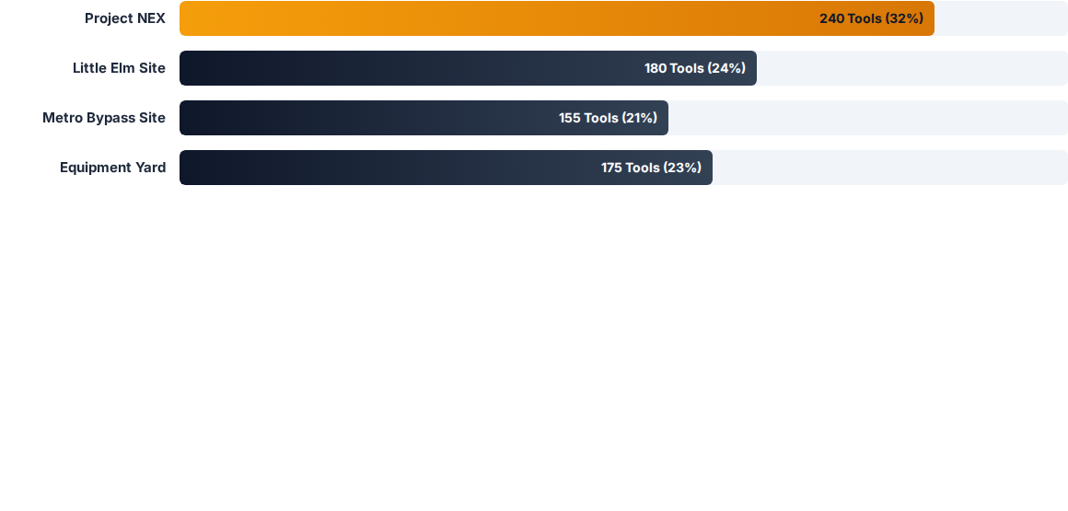


TOOLS BY JOBSITE & CREW BREAKDOWN
Crew Attribution
Hierarchy Drill-Down
Maps tools directly to specific foremen and their immediate crew for total site accountability.
Leadership can drill down from Project Manager level to individual tool serial numbers instantly.

Slide 21
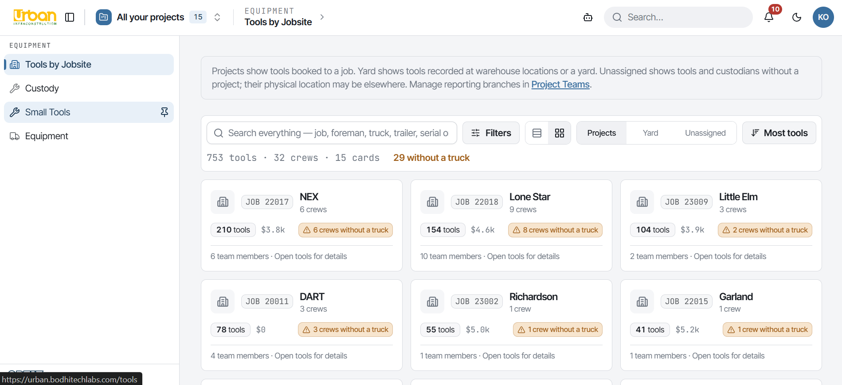

Slide 22










REPORTS, ANALYTICS & LOGS
12 Built-In Report Modules Delivering Operational & Financial Fleet Intelligence
Asset Register Report
Assets by Project
Idle Asset Report
Capital by Project
Full fleet inventory count with categorizations, age, condition, and maintenance logs.
Live tool deployment counts per job site for allocation re-balancing between projects.
Identifies unassigned tools sitting in yards or trailers, preventing duplicate procurement.
Calculates the total dollar capital valuation of tools tied up across each active project site.

Slide 23
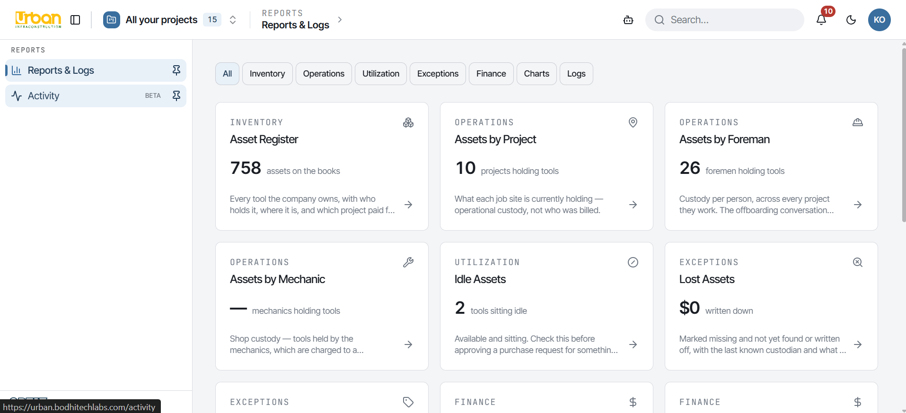

Slide 24
ROLE-BASED ACCESS CONTROL
Tailored Views Ensuring Every User Sees Exactly What Their Role Requires
Equipment Desk: Owns yard inventory. Receives stock, approves hand-offs, and reassigns tools during worker exits.
Field Foreman: Fast 1-tap phone app UI to request, receive, and hand off tools for immediate crew members.
Project Manager: Sees and manages all tools allocated to their active job sites with financial capital tracking.
Mechanic & Shop: Holds tools for maintenance and repairs, charging service time to specific project departments.
Superintendent: Oversees foremen under their supervision; approves inter-job site tool transfers.

Slide 25






MEASURABLE BUSINESS OUTCOMES
100%
$0
1-Tap
Live
Digital Trail History
Duplicate Capex Spend
Offboard Reassignment
Executive Oversight
Zero Missing Tool Records
Instant Offboarding
Unbroken digital history from day one of purchase through field transfers and yard returns. No lost paper trail.
Reassign all inventory held by an exiting crew member in a single action, preventing tool leakage during turnover.

Slide 26

Thank You
Questions & Discussion
Bodhi Labs Pvt. Ltd.
urban.bodhitechlabs.com
Sankhamul, Kathmandu, Nepal
Bodhi Labs · Optix Small Tools Inventory
Q&A

